Slide 1
DIRECTV BULK STREAMING TV
THE ONLY NATIONAL OVER-THE-TOP BULK STREAMING SOLUTION AVAILABLE FOR MDU
Delight Residents Grow Your Revenue No New Infrastructure No Satellite Dish Required
Notes:
PROPERTY OWNER VERSION

Slide 2
Availability of channels vary by package.

Slide 3
Streamers And TV Fans Agree, MDU DIRECTV Bulk Streaming Is The Best Of Live TV And On Demand At A Discounted Price
Launched In 2023
60,000+ Bulk MDU Units Signed In 2023
Over 15M+ Customers Nationally
Unmatched Premium Content For All Residents
No Satellite Dish Required; Delivered Over Your Internet
DIRECTV Is The Ultimate Content Aggregator

Slide 4
Why Is DIRECTV Bulk Streaming Service The Right Solution For Your Property?
PROPERTY OWNER BENEFITS
Best Value, Most Content, Lowest Price
No New Infrastructure, No Capital, and No Technician Needed
Attract and Retain New Residents
Premium Content that Just Needs Internet
Partner with a Streaming Content Provider Committed to Content
Courtesy Accounts Available with Premium Content
Notes:
PROPERTY OWNER VERSION

Slide 5
PROPERTY OWNER BENEFITS | PACKAGES
DIRECTV provides national bulk pricing with a device and Cloud DVR included. This means that residents get immediate access to world-class content – all the TV, movies, news, and premium sports networks they want.
Package | Channel Count | Retail Price | Discounted Price/Unit | Bulk Savings!
ENTERTAINMENT | 75+ Live TV, Locals, Top channels 65,000+ On Demand* | $89.99¹ | $25.00 | $64.99
CHOICE | 105+ Live TV, Locals, Top channels, RSNs, Specialty sports networks 75,000+ On Demand* | $122.98^{1,2} | $36.00 | $86.98
ULTIMATE | 140+ Live TV, Locals, Top channels, RSNs, Specialty sports networks 85,000+ On Demand* | $152.98^{1,2} | $49.50 | $103.48
¹Retail pricing for Entertainment package includes base package plus the $15 monthly Advanced Receiver Service fee. ²CHOICE and Ultimate also includes the monthly $17.99 RSN fee.
*High speed internet-connected compatible device required. Actual number of shows and movies will vary based on programming package. Additional fees apply for new releases and certain library titles.
Notes:
PROPERTY OWNERS = residents

Slide 6
PROPERTY OWNER BENEFITS | PACKAGES
With DIRECTV, you can provide residents with immediate access to world-class content. That means all the TV, movies, news, and premium sports networks they want – whether you have 10 or 10,000 units.
Package | Channel Count
ENTERTAINMENT | 75+ Live TV, Locals, Top channels 65,000+ On Demand*
CHOICE | 105+ Live TV, Locals, Top channels, RSNs, Specialty sports networks 75,000+ On Demand*
ULTIMATE | 140+ Live TV, Locals, Top channels, RSNs, Specialty sports networks 85,000+ On Demand*
And So
Much More!!
*High speed internet-connected compatible device required. Actual number of shows and movies will vary based on programming package. Additional fees apply for new releases and certain library titles.

Slide 7
PROPERTY OWNER BENEFITS | PREMIUM CHANNELS
Give residents even more with premium channels.
Channel | Retail Price | Discounted Price/Unit | Bulk Savings!
 | $16.99 | $3.75 | $12.24
 | $12.99 | $0.99 | $11.00
 | $10.99 | $6.60 | $4.39
 | $6.99 | $3.00 | $2.99
Includes HBO & Cinemax

Slide 8
PROPERTY OWNER BENEFITS | PACKAGES, ENTERTAINMENT BUNDLE
ENTERTAINMENT Package
Unparalleled Content Bundle
75+Channels
65,000 On Demand Titles
+
ONLY $29.24 PER UNIT + TAXES
$119.97
Bulk savings is based on Entertainment package residential pricing ($74.99), Max pricing ($16.99), Paramount+ with SHOWTIME pricing ($12.99), and monthly ARS fee ($15).
*High speed internet-connected compatible device required. Actual number of shows and movies will vary based on programming package. Additional fees apply for new releases and certain library titles.

Slide 9
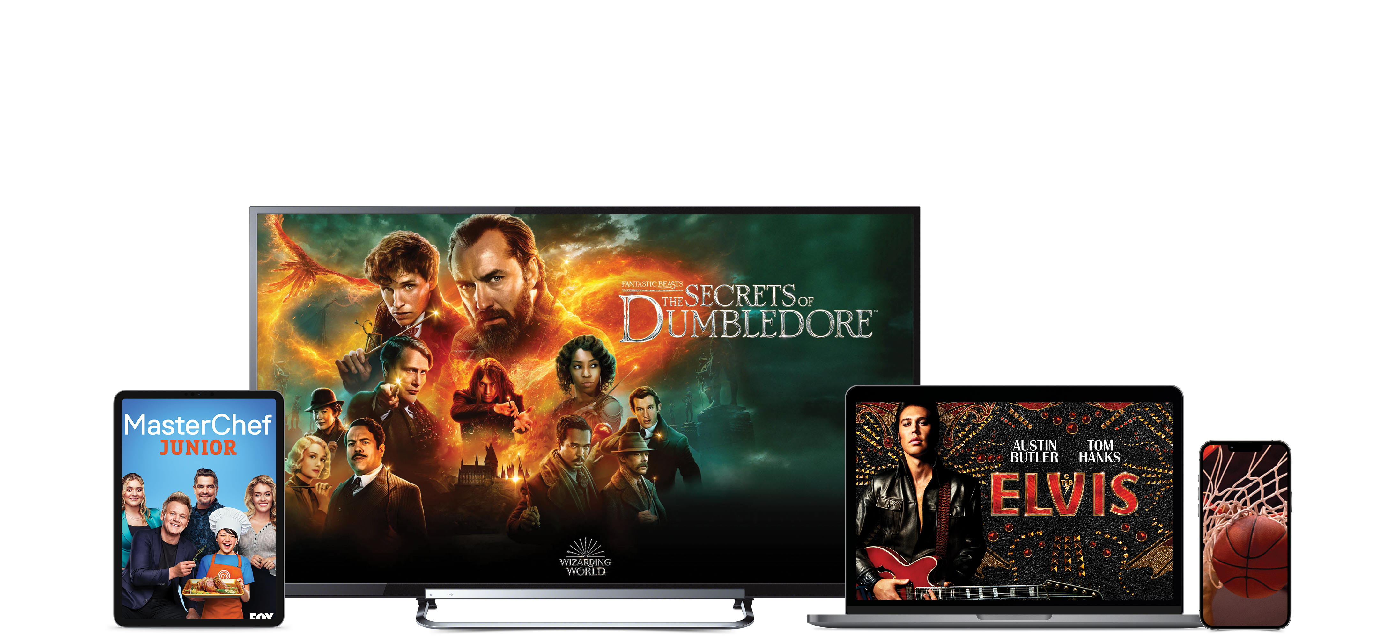
PROPERTY OWNER BENEFITS | PACKAGES, CHOICE BUNDLE
CHOICE Package
Best Value with Sports
105+Channels
75,000 On Demand Titles
+
ONLY $39.74 PER UNIT + TAXES
$152.96
Bulk savings is based on CHOICE package residential pricing ($89.99), Max pricing ($16.99), Paramount+ with SHOWTIME pricing ($12.99), monthly ARS fee ($15) and monthly RSN fee ($17.99).
*High speed internet-connected compatible device required. Actual number of shows and movies will vary based on programming package. Additional fees apply for new releases and certain library titles.

Slide 10
PROPERTY OWNER BENEFITS | COMPATIBLE DEVICES
The Resident Is In Control
Compatible mobile devices, tablets, and browsers connected to a cellular network
Compatible streaming devices or TV
Wired or Wi-Fi® internet connection for TV streaming devices
DIRECTV Streaming TV account
DIRECTV app downloaded from your device’s app store
***Get Info on Compatible Devices | DIRECTV Customer Service & Support
Notes:
PROPERTY OWNER = RESIDENT

Slide 11
RESIDENT BENEFITS
Don’t settle. Give your residents the content they want.
Get the most popular channels, no matter which programming package you choose. Based on 2023 Nielsen ratings.
20 hours of cloud DVR storage included in every package.
Local and national channels streaming on all screens. Some local channels not available in select markets
Easily access live TV and thousands of streaming apps like Netflix, Max, Prime Video, and more.
Our streaming device is portable.
Easy self-setup and installation.
DIRECTV is your home for regional sports, with the most in-market RSNs. Compared to cable, Dish and most streaming providers. RSNs avail. with CHOICE package or higher. Availability of RSNs varies by ZIP code and package.
Gemini’s voice remote lets you quickly find your shows and entertainment – just ask Google. Internet connection required. Google login req’d. Google, Google Play, and Android TV are trademarks of Google LLC.

Slide 12
RESIDENT BENEFITS
OUR BEST EQUIPMENT IS INCLUDED!
Gemini Offers Enhanced Features
Easy access to your favorite apps, a wireless 4K experience on every compatible TV via your favorite apps and a voice-controlled remote. Req's separate paid subscriptions to 3rd party apps. High speed internet-connected compatible device required. Google login required.
Quick & Easy Self Set-up
Self-setup is easy, and no technician or installation equipment is needed.
Take It With You
The Gemini device is portable.
Notes:
NON 55+ SEGMENTS

Slide 13
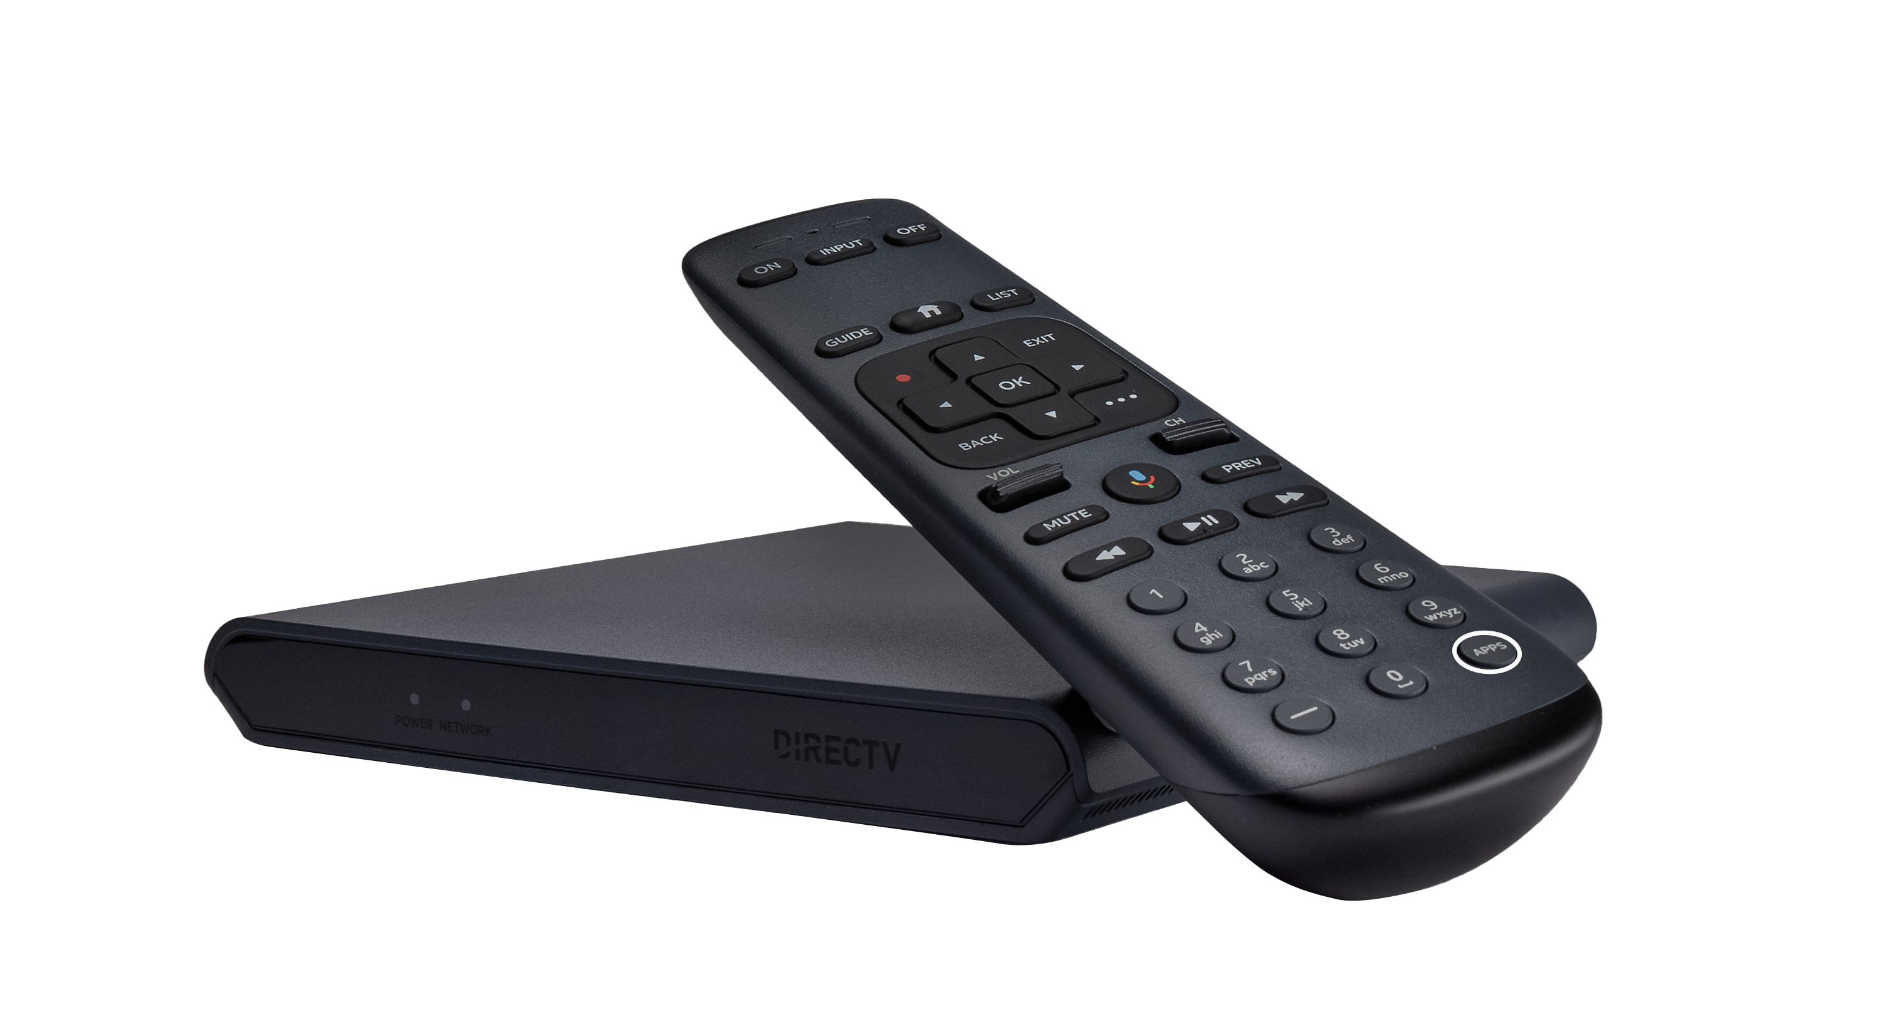
RESIDENT BENEFITS
OUR BEST EQUIPMENT IS INCLUDED!
Gemini Offers Enhanced Features
Easy access to your favorite apps, a wireless 4K experience on every compatible TV via your favorite apps and a voice-controlled remote. Req's separate paid subscriptions to 3rd party apps. High speed internet-connected compatible device required. Google login required.
Quick & Easy Self Set-up
Self-setup is easy, and no technician or installation equipment is needed.
Take It With You
The Gemini device is portable.
Notes:
ALT Version for 55+ audience / HOA AUDIENCE

Slide 14
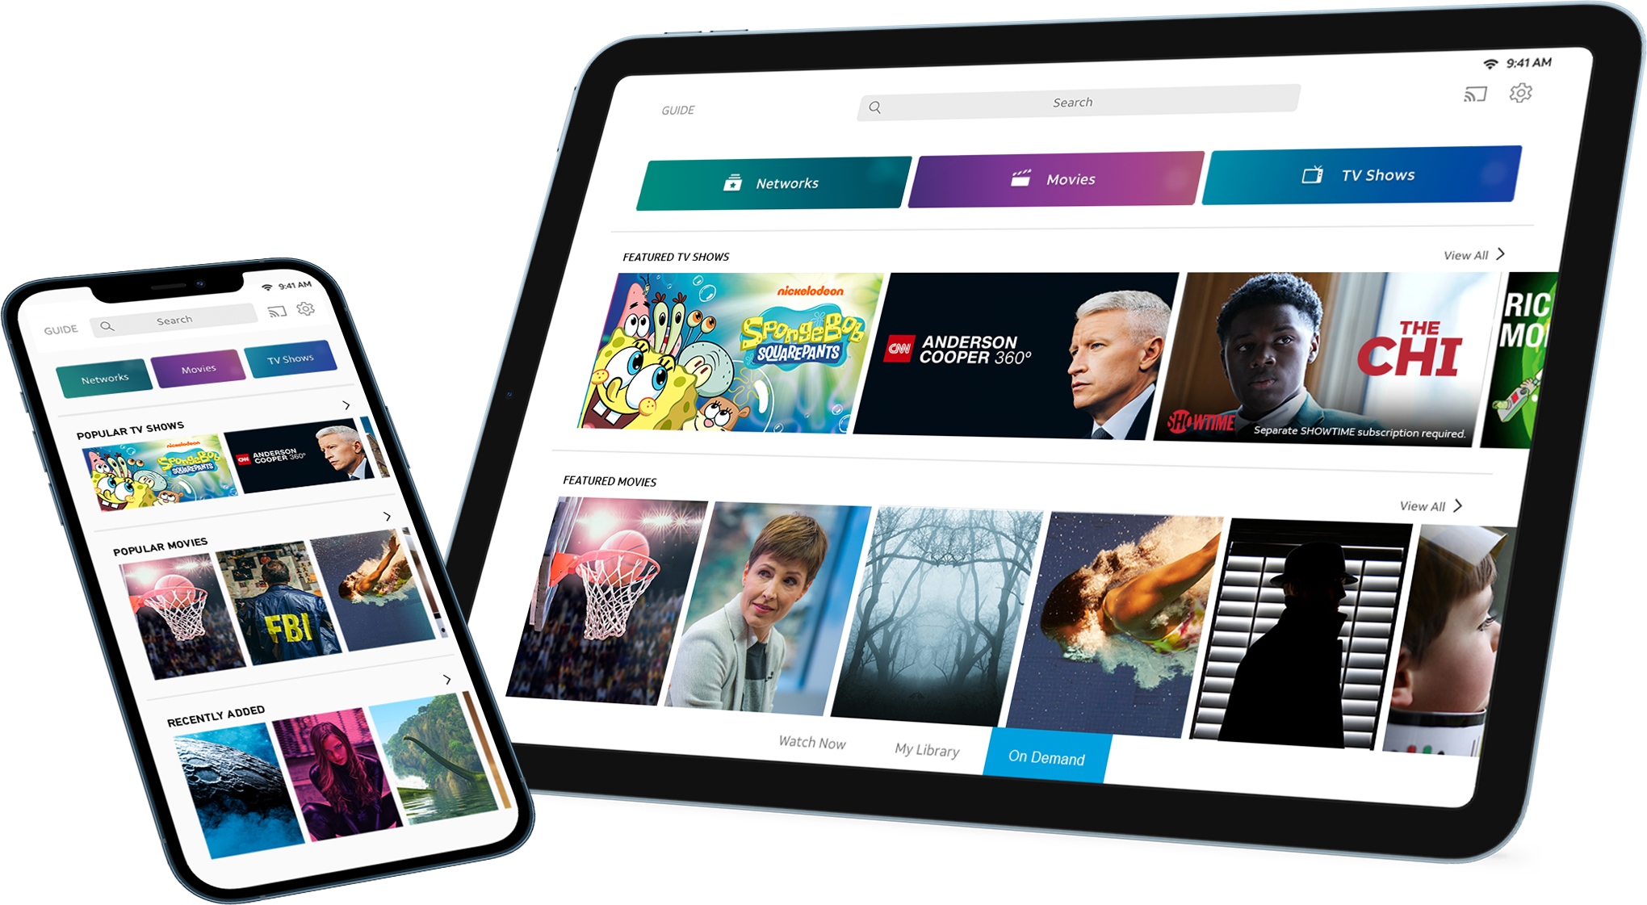
RESIDENT BENEFITS | THE APP
Your Content Everywhere
Watch on smart TVs and streaming
devices while you’re away from
home via the DIRECTV app.
Available only in the U.S. (excl. Puerto Rico and U.S.V.I.). Req’s compatible device and data connection; data charges may apply. Not all channels available to stream. Limited to up to 3 concurrent streams. Restr’s apply. Visit directv.com/app for more information.

Slide 15
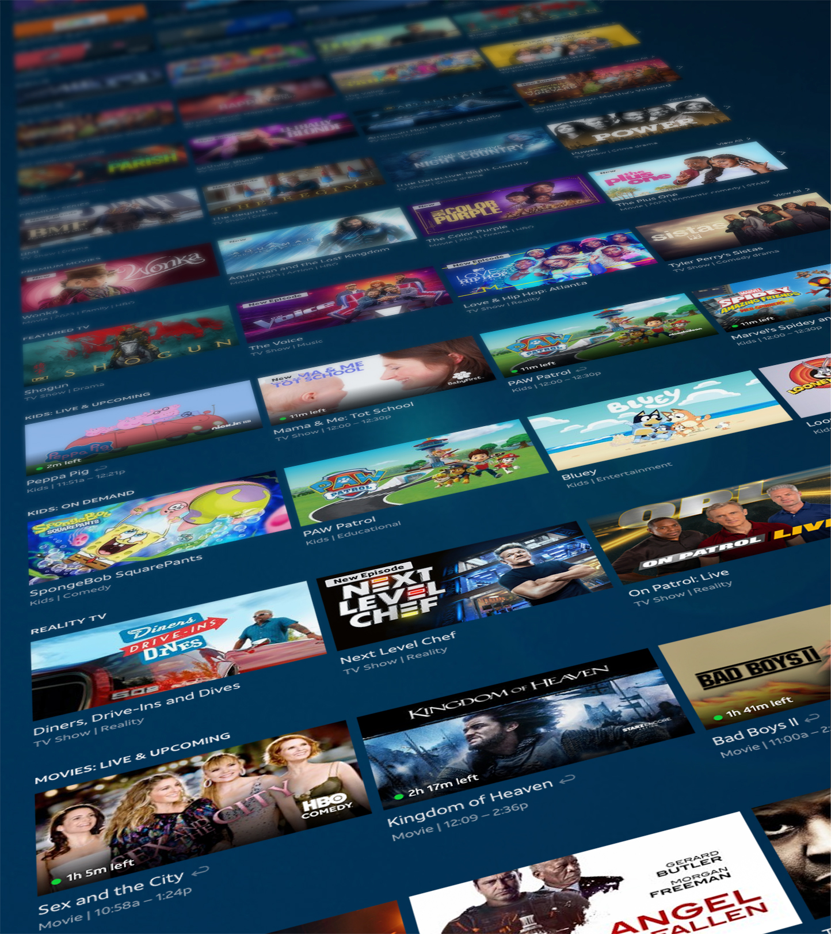
“
CLOSING | TESTIMONIALS
User interface of DIRECTV Stream was clean, easy to navigate. Jumping from channel to "on demand" options are very quick and seamless.
Keys Gate
We signed up for DIRECTV on Monday and we were instantly able to use the app on our Apple TVs and iPad. Now I can’t wait to cancel that extra internet speed package we pay for!
Palm Isle Estates
Picture quality is clearer, crisper, and brighter than U-Verse since all channels come in at 1080p resolution.
Keys Gate
I was able to activate the account and start streaming right away. Super easy.
Oaks at Boca

Slide 16
Pair DIRECTV Stream Bulk Services with your Internet Solution
and make premium entertainment standard in every unit.
Don’t miss the opportunity to bring this brand new, and only national bulk streaming product to your community!
Notes:
PROPERTY OWNERS & HOA = community

Slide 17
Pair DIRECTV Stream Bulk Services with your Internet Solution
and make premium entertainment standard in every unit.
Premium content at an unparalleled value
100% Streaming, no dish required
Simple and easy setup
Courtesy accounts for common areas on property
Portability of the product
No customer installation, no truck roll, no technician needed
No additional cost to deliver premium content over your Internet
Notes:
Alt version to previous slide

